Slide 1

Project - Flag
Computer Graphics
MIEIC
Wave animation
Teresa Matos
14-15 May 2020

Slide 2
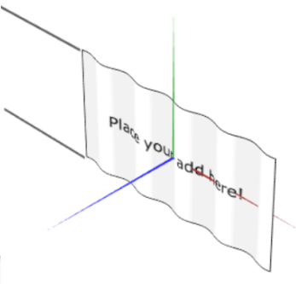
MyFlag
A 2D plane with a sine wave animation, created with shaders:
The vertex shader changes the Z value of each vertex
The fragment shader maps the custom texture
The changes in Z follow a sinusoidal function and vary according to time and the vehicle’s speed

Slide 3
Steps for vertex animation in shaders
A new class MyFlag may be created to implement the animated flag. The general steps for creating this flag are:
Create and display the basic flag, without shaders
Create and apply the shader files, creating a static wave effect
Use time to animate the wave effect
Apply vehicle’s velocity to the animation
An object of MyFlag is added to MyVehicle, which calls the flag’s display() and update() functions

Slide 4
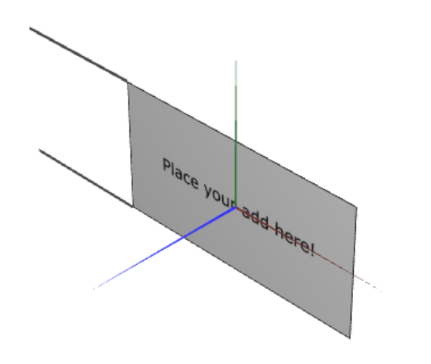
1 Basic Flag without shaders
In the MyFlag class, we add:
An instance of MyPlane and CGFtexture
The update(t) function, to be called by MyVehicle.update(t)
The display() function, to be called in MyVehicle.display()
Basic flag with custom texture
In the display() function, MyPlane object is drawn, the texture is applied, as well as some geometric transformations.

Slide 5
2 Shaders - Base code
Now, we create the vertex and fragment shader files, and load them into a CGFshader object.
The examples from TP5 may be used to create the basic shaders:
texture1.vert
void main() {
gl_Position = uPMatrix * uMVMatrix * vec4(aVertexPosition, 1.0);
vTextureCoord = aTextureCoord;
}
texture1.frag
void main() {
gl_FragColor = texture2D(uSampler, vTextureCoord);
}

Slide 6
2 Shaders - Static wave effect
To create an horizontal wave effect, we add an offset to the Y coordinates
This offset will be follow a sinusoidal function
The variable used in this function must vary throughout the plane, horizontally
Should we use:
An attribute variable
or
A uniform variable, passed to the shaders by our class?

Slide 7
2 Shaders - Static wave effect
The attribute variables, such as aVertexPosition, are defined per-vertex, and so can be used for this effect.
We can use one of the components of the vertex position, or the texture coordinates:
offset.z = aVertexPosition.?
Or
offset.z = aTextureCoord.?

Slide 8
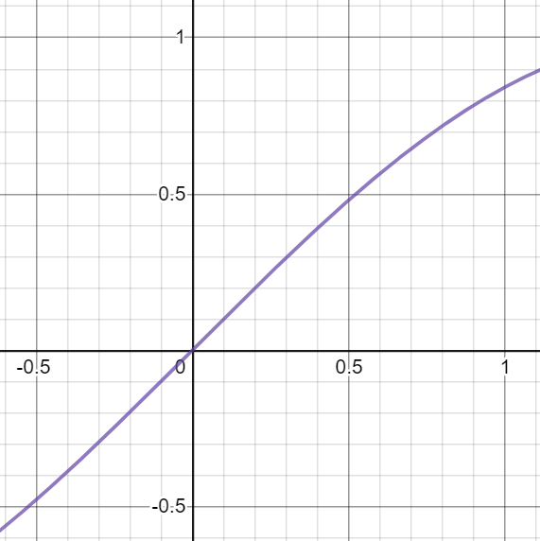
2 Shaders - Static wave effect
f(x) = sin(x)
A sinusoidal function with either option does not result in the expected wave effect due to their value range.
Adding a multiplier to our equation:
offset.z = sin(aVertexPosition.x * mult)
or
offset.z = mult * sin(aVertexPosition.x)
Vertex position [-0.5;0.5]
Texture coords [0; 1]

Slide 9
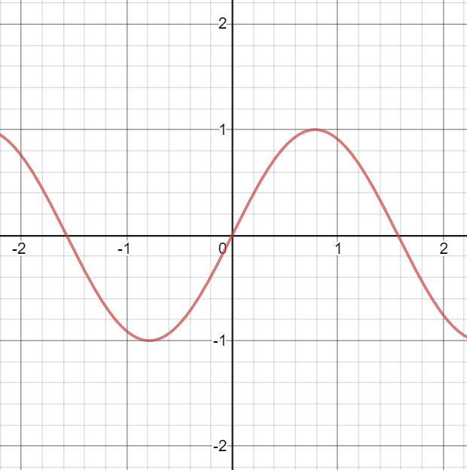
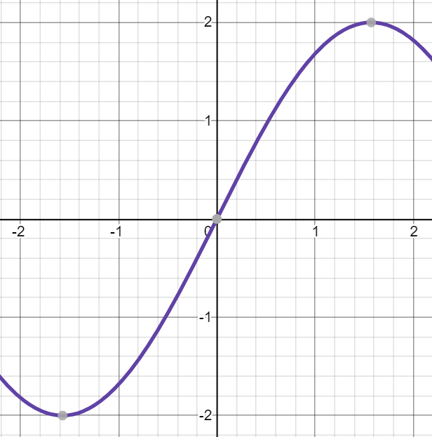
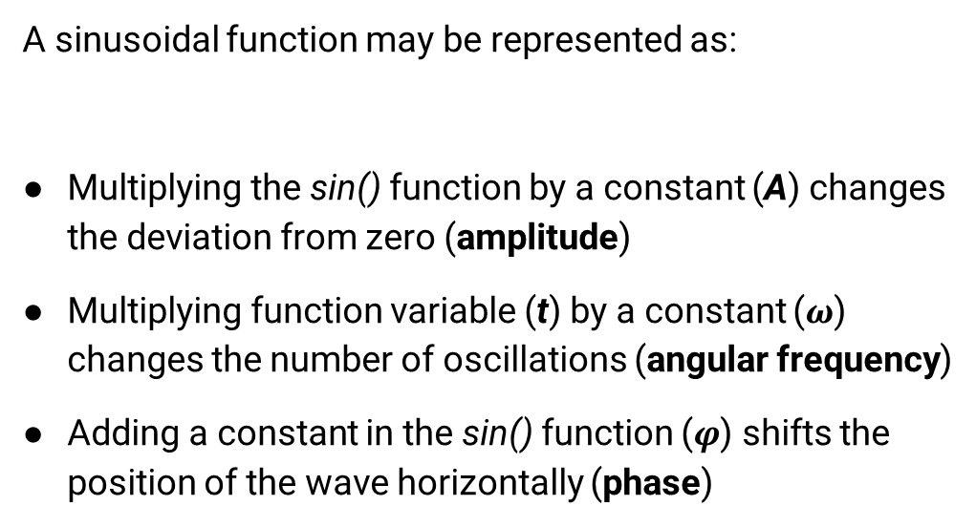

2 Shaders - Static wave effect
A sinusoidal function may be represented as:
Multiplying the sin() function by a constant (A) changes the deviation from zero (amplitude)
Multiplying function variable (t) by a constant ($ω$) changes the number of oscillations (angular frequency)
Adding a constant in the sin() function ($φ$) shifts the position of the wave horizontally (phase)
$$y\left(t\right)=A∗sin⁡(ω∗t+φ)$$
f(x) = sin(2*x)
f(x) = 2*sin(x)

Slide 10
3 Shaders – Animated wave
To animate the wave effect, we need to move it horizontally through time
The phase variable, representing an offset in the X axis:
Starts with value zero
Is updated according to the time between frames (delta time)
update(t){
… this.phase += deltaTime;
this.shader.setUniformsValues({phase: this.phase});
…
}

Slide 11

4 Shaders – Animated wave with vehicle’s speed
To apply vehicle’s speed, its value is passed to the update() function
Considering the speed function
$$v=\frac{dx}{dt}$$
update(t, speed){
deltaT = …
deltaX = …
this.phase += deltaX;
this.shader.setUniformsValues({phase: this.phase});
…
}

